Slide 1


3 Horizons Framework
Presented by -
Prasad Shubham Marco Enzo Ameena Joern
Jagtap Ingole Squillacioti Butt Appelt

Slide 2
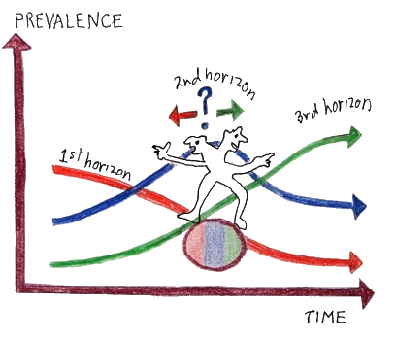
Introduction
3H was developed by Bill Sharpe of International Futures Forum (IFF) as part of work for the UK Foresight Program’s Intelligent Infrastructures project.
3H has proven widely useful as a conceptual model to aid people thinking about current assumptions, emerging changes, and possible & desired futures.
3H connects the present with desired futures and helps to identify the divergent futures which may emerge as a result of conflict between the embedded present & imagined future.
3H maps overlapping waves of change visible in the present as mindsets: managerial, visionary, and entrepreneurial.

Slide 3
Contents
Concept
Descriptive application of the tool
Summary
Adaptation of the framework
Example
Pros & Cons of the framework

Slide 4

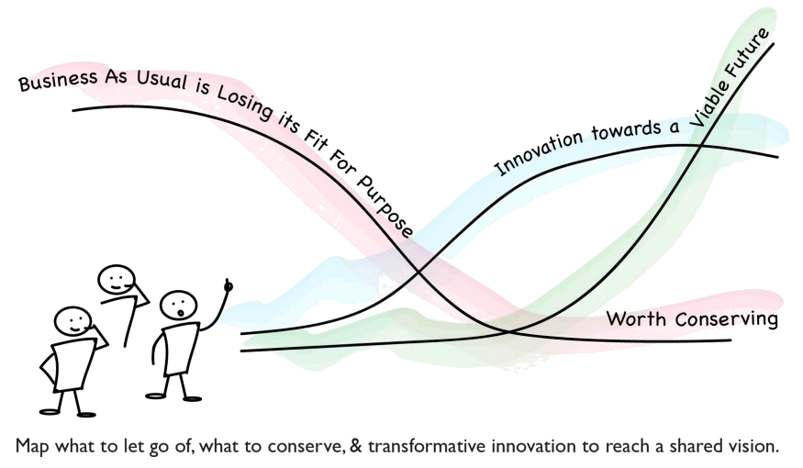
Concept
What it is ?
an approach to sense-making overlapping waves of uncertain change in the context of current assumptions.
What it needs ?
knowledgeable facilitator; diversity of contributors; modelled data.
3H helps by asking people first to make their assumptions explicit, and then to explore emerging change to reframe what they think, what they want, and what they do.
The final step looks back at history, forward at the possibilities, and creates actions that bridge from today to tomorrow.
Notes:
We typically introduce the horizons and think about the way the dynamic changes between them over time, in this order: H1 – H3 – H2. Because without a third horizon it is impossible to make the distinction between ‘sustaining innovation’ (H2-) and ‘transformative innovation’ (H2+).

Slide 5
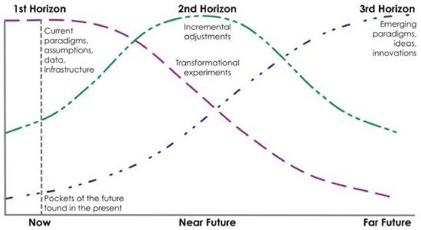
The Three Horizons
First Horizon: Current context and conditions, it represent business as usual. We rely on these systems being stable and reliable.
Third Horizon: Transformative changes, thoughts for alternative futures, and visions of desired futures; the emphasis is on transformation and disruption.
Second Horizon: Actions taken in the present to resist change, to adapt to change, or to develop on change; the aim is on creating and managing alternatives.
Notes:
We typically introduce the horizons and think about the way the dynamic changes between them over time, in this order: H1 – H3 – H2. Because without a third horizon it is impossible to make the distinction between ‘sustaining innovation’ (H2-) and ‘transformative innovation’ (H2+).
1-current
3-future tansformative
2-actions taken in present

Slide 6
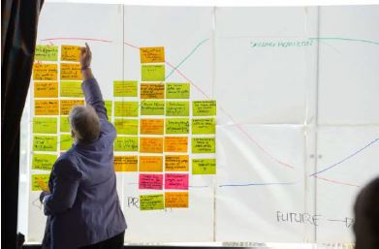
Horizon 1
The current state of play: The dominant system and the challenges to its sustainability into the future.
What are the current working assumptions about production, services, resources, staff, customers, capital?
What is the current state of play?
What are managers taking for granted when they make decisions?”

Slide 7
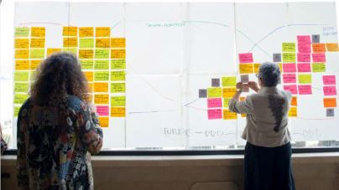
Horizon 3
The desirable future state: The step is to identify emerging changes that represent transformational shifts from the present by asking questions like:
What changes are emerging as completely new models and novel means to understand and undertake various activities?
What are the new issue or invention you are worried - or excited about?
What are visionary leaders saying?”
Notes:
H3 - emerges as the long-term successor to business as usual. It grows from fringe activity in the present that introduces completely new ways of doing things, but which turn out to be much better fitted to the world that is emerging than the dominant H1 systems. The desirable future state, the ideal system we desire and of which we can identify elements in the present that give us encouragement and inspiration

Slide 8
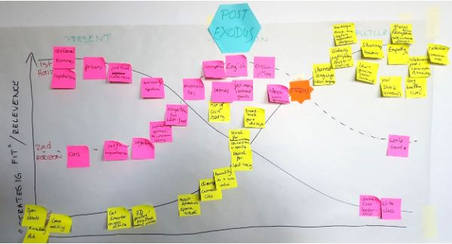
Horizon 2
The link between present and future: The step is to identify the transition between the assumptions and the emerging changes
Which assumptions will be most challenged by the emerging changes?
How can the emerging changes be used to create something new?
Is there a new business model, production process or new customer segment?

Slide 9

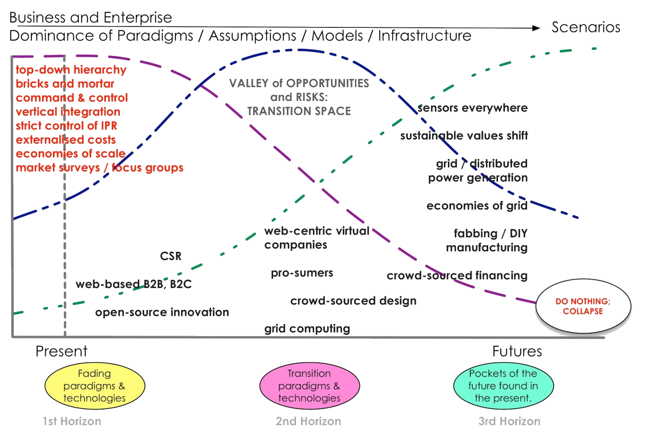
Summary
Notes:
To wrap up all the steps:
We have on the left side the present. Purple line is how current assumptions will drive the business if nothing is done. We can see on the green line what is called pockets of the future in the present.
On the right we have the emerging changes. These are the ones that will challenge our present assumptions.
In the middle we have the transition

Slide 10
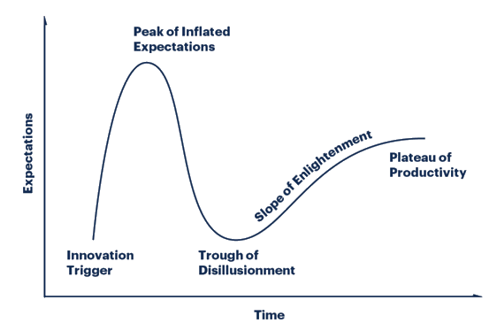
How to Adapt the 3H Framework
How do Hype Cycle work?
Innovation Trigger: A potential technology breakthrough, early proof-of-concept stories and interest trigger significant publicity.
Peak of Inflated Expectations: Early publicity produces a number of success stories — often accompanied by scores of failures.
Trough of Disillusionment: Interest wanes as experiments and implementations fail to deliver. Producers of the technology shake out or fail.
Slope of Enlightenment: More instances of how the technology can benefit the enterprise start to crystallize and become more widely understood. Second- and third-generation products appear
Plateau of Productivity: Mainstream adoption starts to take off. Criteria for assessing provider viability are more clearly defined.
Notes:
Each Hype Cycle drills down into the five key phases of a technology’s life cycle.

Slide 11

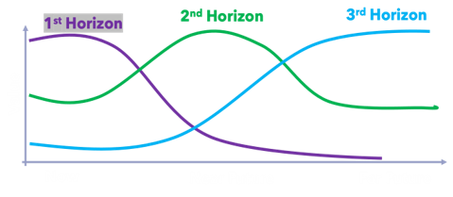
Example:
Large Organization with many large teams leads to different visions for company’s & team’s future
1st Horizon: Business as usual
People should still do supportive tasks outside the projects
3rd Horizon: Transformation
Green manufacturing
Higher automation in production
2nd Horizon: Actions taken in the present
Lead Time reduction
Better communication between 4 Final Assembly Lines (GER, FRA, USA, CHI)

Slide 12
Pros and Cons
Benefits of the 3H model
What doesn’t the 3H model do?
Makes people agree and understand on one common vision
People start to understand why long-term innovations take time and why those projects are worth
People start to adopt an innovation mindset
Doesn’t map innovation types
Doesn’t map markets to play in
For determining types of innovation to pursue after using the 3H model, innovation landscape tool (Gary P. Pisano) is needed in addition.

Slide 13

References -
https://training.itcilo.org/delta/Foresight/3-Horizons.pdf
https://www.iffpraxis.com/three-horizons
https://jfsdigital.org/wp-content/uploads/2014/01/131-A01.pdf
https://www.boardofinnovation.com/blog/what-is-the-3-horizons-model-how-can-you-use-it/

Slide 14
Questions?

Slide 15
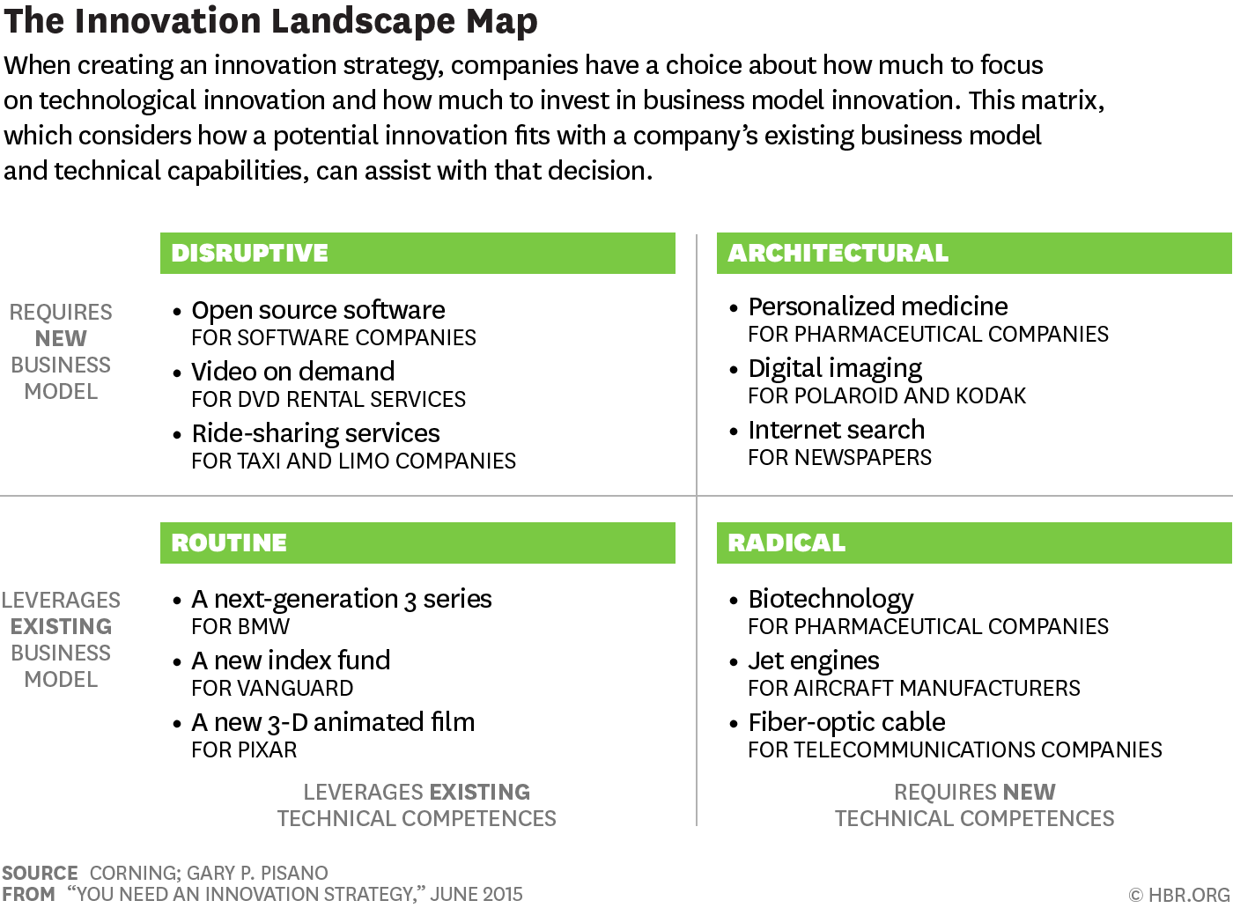

Slide 16
